Slide 1
Emertxe IoT Internship
IoT Based Project Home Automation
By Gopisetti Gopi
Study World College Of Engineering,Coimbatore
B.E/CSE,Final Year

Slide 2
Table of contents :
About the Internship
Topics learned in this Internship
What is IoT?
What is embedded system?
C/ C++(OOPs concepts)
About the Project
Implementation of the Project
conclusion

Slide 3
About the Internship:
Emertxe information technology, Bangalore
Duration 4 weeks
Organized, Structured, and Standard
Learning with implementation
Student Support (Moodle LMS)
Free Resources and Tools
Project based learning
Weekly Evaluation of student

Slide 4
Project Part
Learning Part
Peripherals
Arduino programming
Picsimlab Simulation
Blynk IoT App
Home automation Project
C/C++ Programming
OOP’s Concepts
IoT Introduction
Embedded System
Workshop

Slide 5
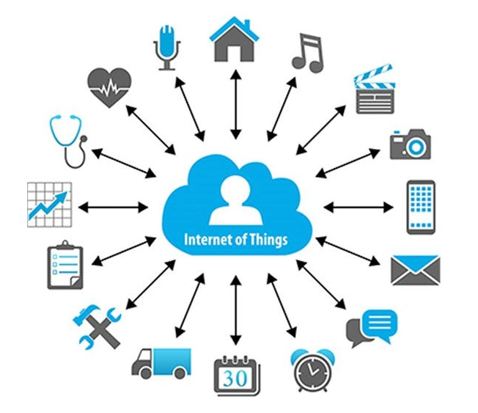
What is IoT ?
IoT — The Internet of Things
Internet : Network Things : Objects
The Internet of Things (IoT) is a network of physical objects that are embedded with sensors, software, and other technologies to connect and exchange data with other devices and systems over the internet.
IoT is the network of physical objects
Collection of electronics, software, sensors, and network connectivity, which collect and exchange the data

Slide 6
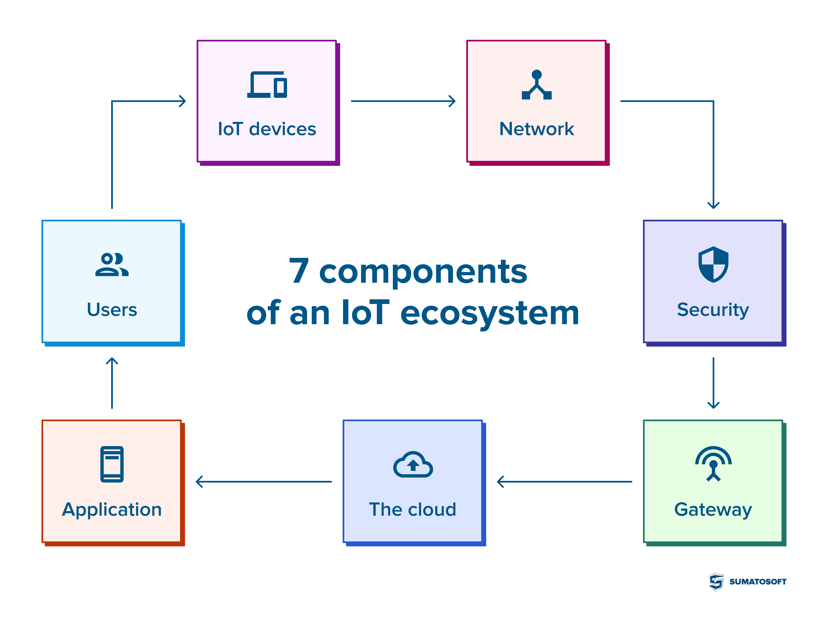
Ecosystem of IoT:
IoT devices
Network
Security
Gateway
The Cloud
Application
Users

Slide 7
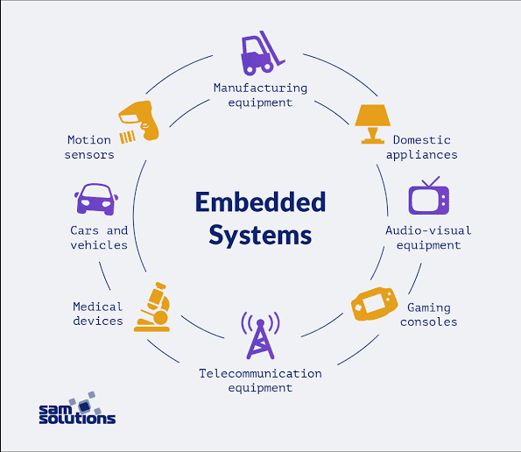
What is Embedded System?
An embedded system is a small computer that's integrated into a larger device or machine to perform specific functions and control the device
An embedded system is a combination of computer hardware and software designed for a specific function.
An embedded system is a computer system which is the combination of a processor, memory, and input/output peripheral devices.

Slide 8
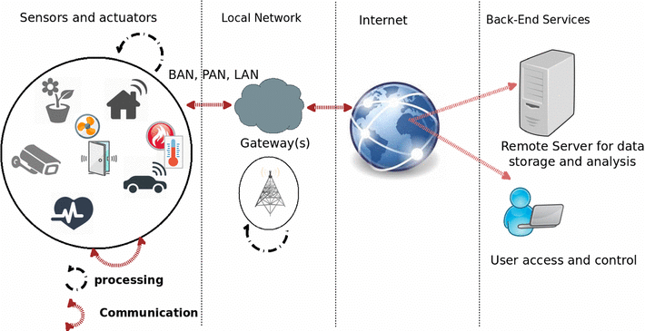
An embedded system and IoT
The difference between an embedded system and the IoT is an embedded system is a subset of IoT

Slide 9

Types of Embedded system:
Self-driving vehicle controls
Aircraft control systems
Medical devices and patient monitoring systems
Digital cameras
Music players
Washing machines
01
Real Time embedded systems
02
Stand alone embedded systems
Home security systems
ATMs (Automated teller machines)
Point of sale systems
03
Networked embedded systems
Cell phones
Laptops
Smartwatches
04
Mobile embedded systems

Slide 10
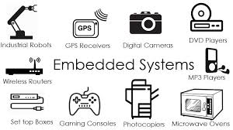
Examples of embedded systems:

Slide 11
C/ C++ Programming
Basics: Intermediate:
Advanced:
Variables
Keywords
Datatypes
Operators
Conditionals
Loops
Arrays
Pointers
Functions
Storage Classes
Files
Preprocessor
C++ Overview
Class and Objects
Abstraction
Inheritance
Encapsulation
Polymorphism

Slide 12
Requirements:
About the project: Home Automation
Garden Lights Control
Temperature control
Heater Control
Threshold Temp. Control
Water Tank control
Inlet and outlet valves control
Display water volume
Displaying the progress and notified on the mobile (Blynk) app and CLCD with automatic actions

Slide 13
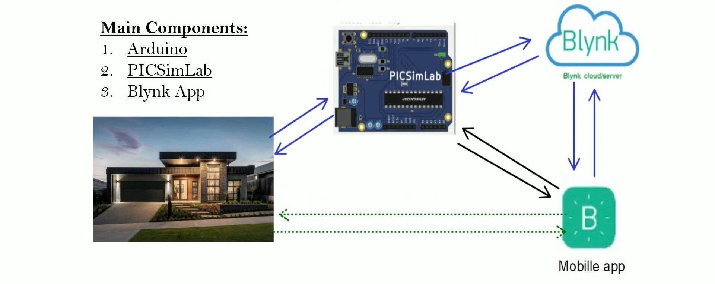

Slide 14
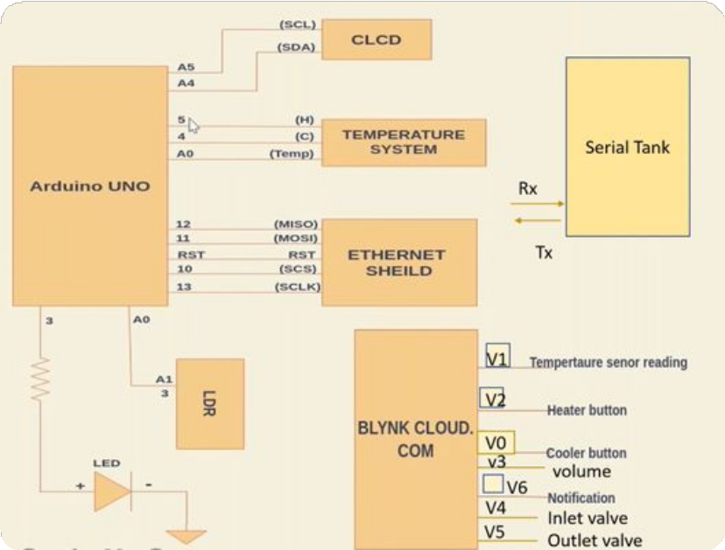
About the Project:
Peripherals:
LED’s
Temperature system
CLCD
LDR
Serial tank (Serial communication)
Ethernet shield

Slide 15
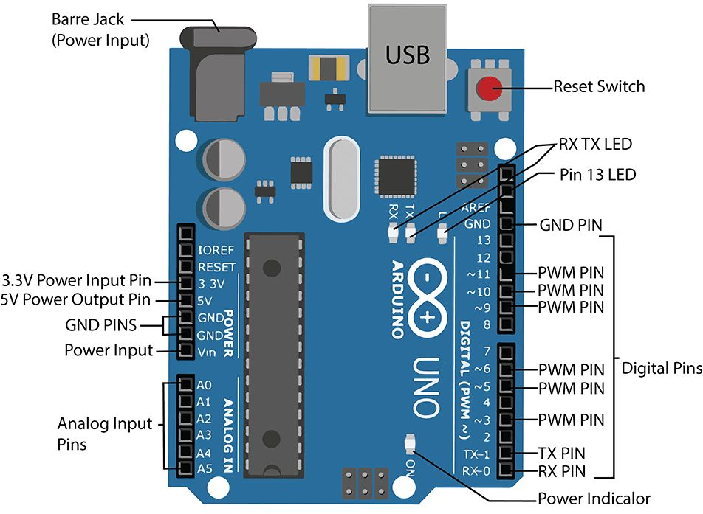
About the Project
Arduino UNO is based on an ATmega328P microcontroller.
It is easy to use compared to other boards, such as the Arduino Mega board, etc. The board consists of digital and analog Input / Output pins (I/O), shields, and other circuits.
The Arduino UNO includes 6 analog pin inputs, 14 digital pins, a USB connector, a power jack, and an ICSP (In-Circuit Serial Programming) header.

Slide 16
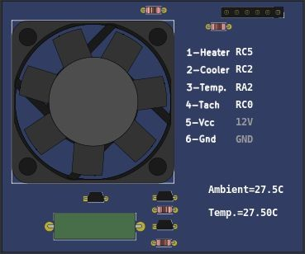
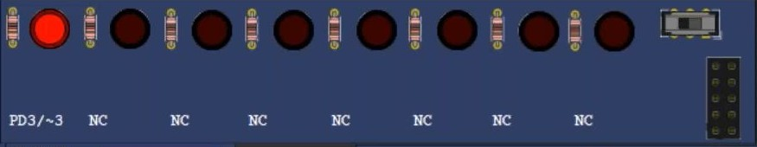
About the Project:
Ds (Light Emitting DiodeLE)
Temperature System

Slide 17
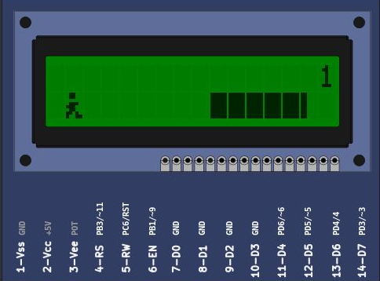
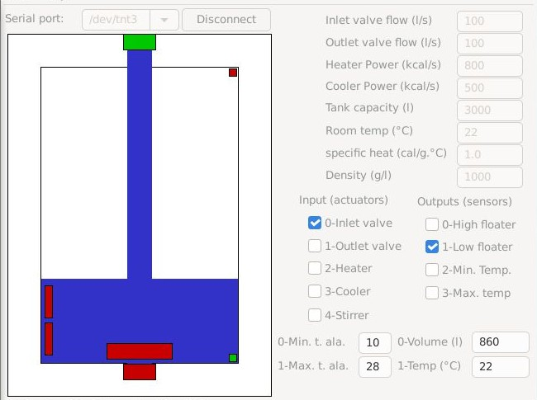
CLCD (16×2) Liquid Crystal Display
Remote serial Tank

Slide 18
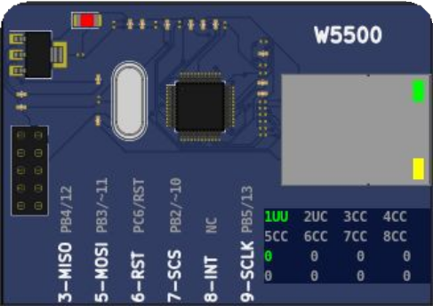
ETH W5500
The W5500 chip is a Hardwired TCP/IP embedded Ethernet controller that provides easier Internet connection to the embedded system.
W5500 enables users to have the Internet connectivity in their applications just by using the single chip in which TCP/IP stack, 10/100 Ethernet MAC and PHY embedded.
Supports Wake on LAN over UDP. Supports High Speed Serial Peripheral Interface(SPI MODE 0,3).

Slide 19
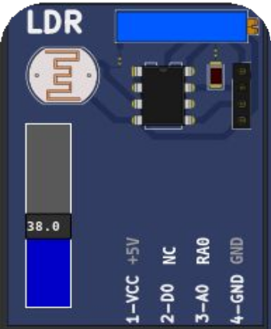

LDR (Light dependent resistor) SENSOR
An LDR is a component that has a (variable) resistance that changes with the light intensity that falls upon it. This allows them to be used in light sensing circuits.
The resistance of a Photo resistor decreases with increasing incident light intensity. In other words, it

Slide 20
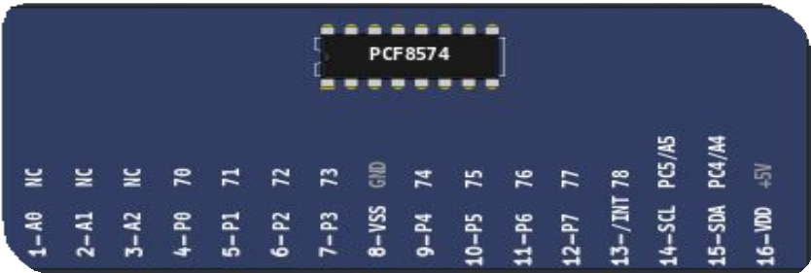
PCF8574
The PCF8574 is a silicon CMOS circuit
It provides general purpose remote I/O expansion for most microcontroller families via the two-line bidirectional bus (12C inter-IC).
The device consists of an 8-bit quasi-bidirectional port and an I2C-bus interface.

Slide 21
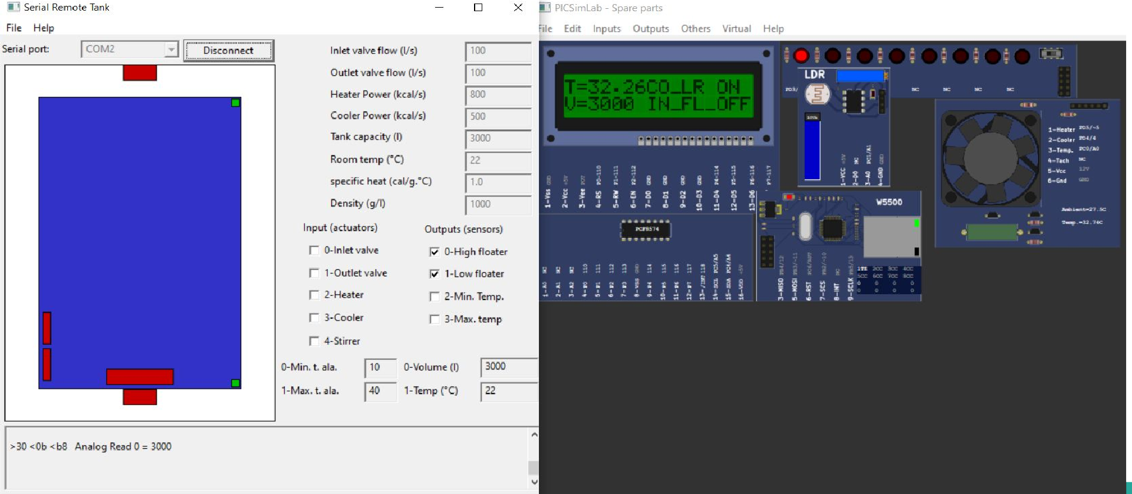
Project Implementation:

Slide 22
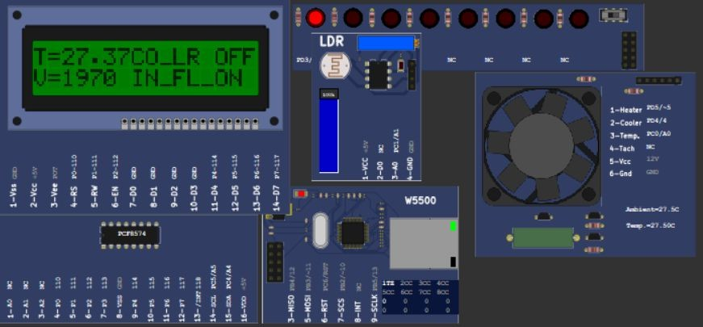
Project Implementation:

Slide 23
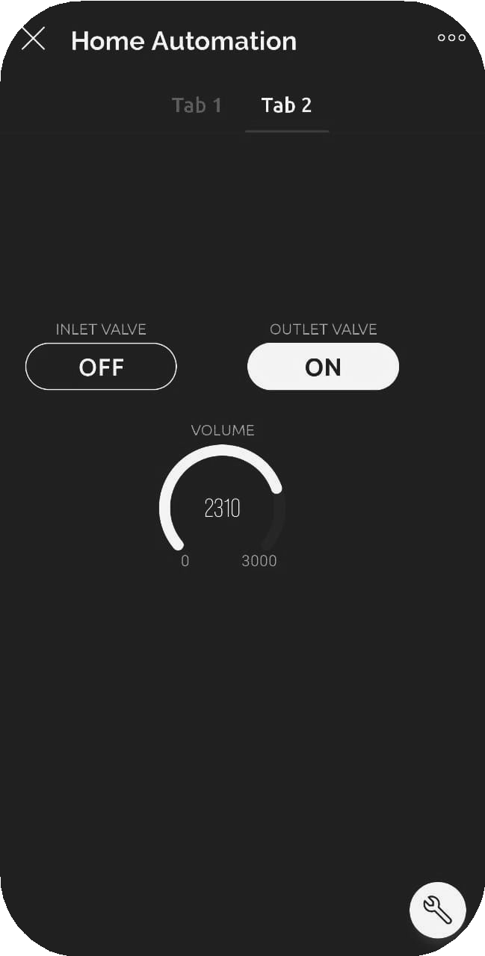
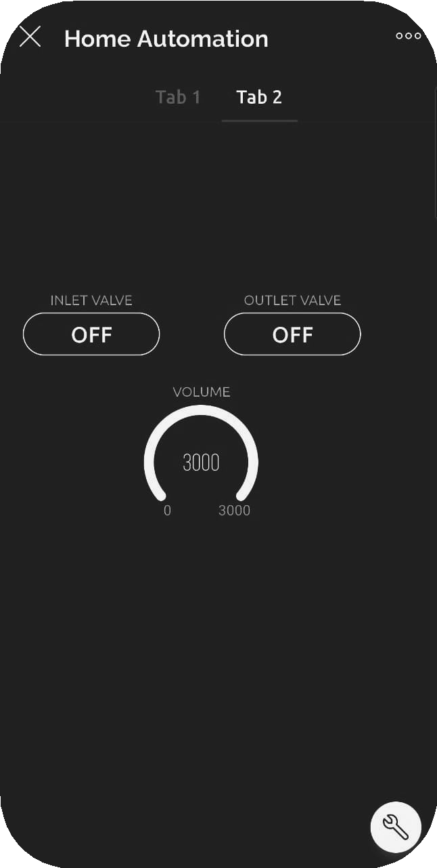
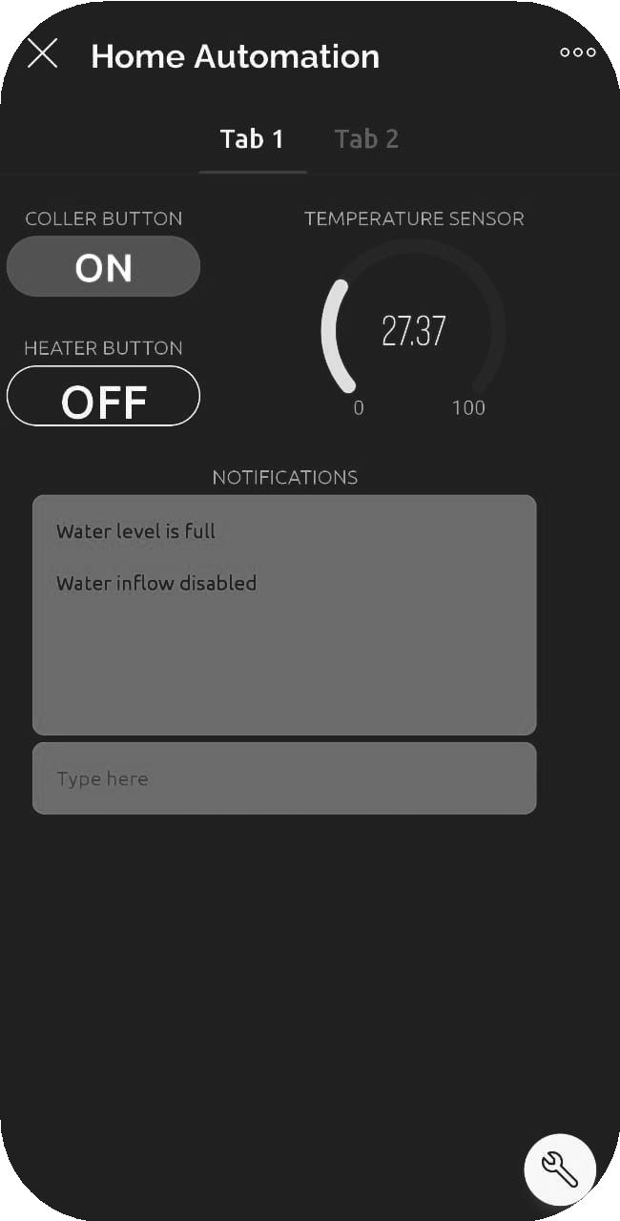
Project Implementation:

Slide 24
IoT applications use machine learning or artificial intelligence (AI) technology to analyze data received from IoT devices and make informed decisions.
Using blynk IoT application and Picsimlab simulator, simulated home automation, where LED, temperature system, Serial tank resembles Light, Heater, Cooler and Water tank in real time.
CLCD acts like a dashboard used for displaying the events, Widgets from Blynk IoT app like button widgets are used to control heater, cooler and inlet valve, outlet valve.
Gauge widgets to display the temperature and volume of the water.

Slide 25
Conclusion:
The home automation project successfully demonstrated the integration of various IoT devices, allowing for efficient control and monitoring of household systems through a centralized platform. The project showcased the potential of smart home technologies to enhance convenience, energy efficiency, and security. Future work could explore the integration of AI for predictive maintenance and enhanced user personalization, as well as expanding the system to include additional devices and compatibility with emerging technologies.

Slide 26
YoutubeLink
Github

Slide 27
Thank You

